Slide 1
Joystick Controlled PC Mouse Using Arduino UNO

Slide 3
Our Team
Al-Ramahi Nidal
1231B

Slide 4
01
CIRCUIT COMPONENTS
INTRODUCTION
02
03
HOW TO BUILD THE CIRCUIT
04
ARDUINO CODE
05
06
EXPLANTATION OF THE PYTHON CODE
PYTHON CODE
07
CONCLUSION

Slide 5
Introduction
This project involves using an Arduino UNO and a joystick module to control a PC mouse. The goal is to understand the basics of interfacing a joystick with Arduino and translating its movements to control a mouse pointer on a computer screen. Applications: - Custom input devices - Gaming controls - Assistive technology for individuals with limited mobility
Joystick Controlled PC Mouse Using Arduino UNO

Slide 6
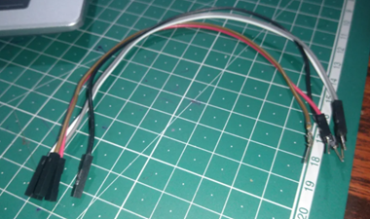
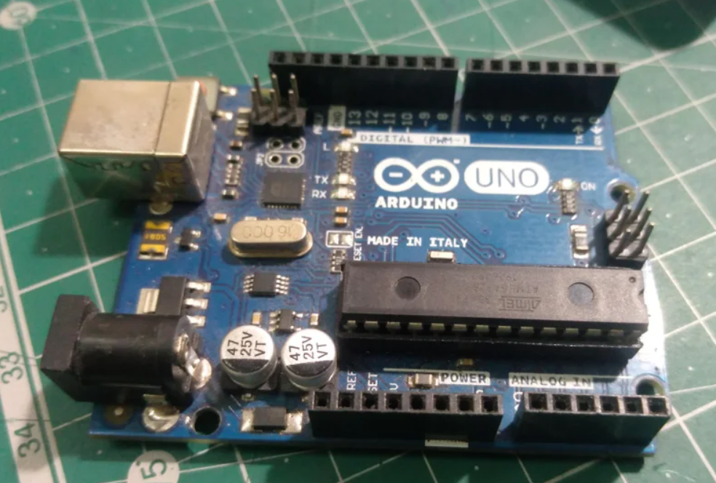
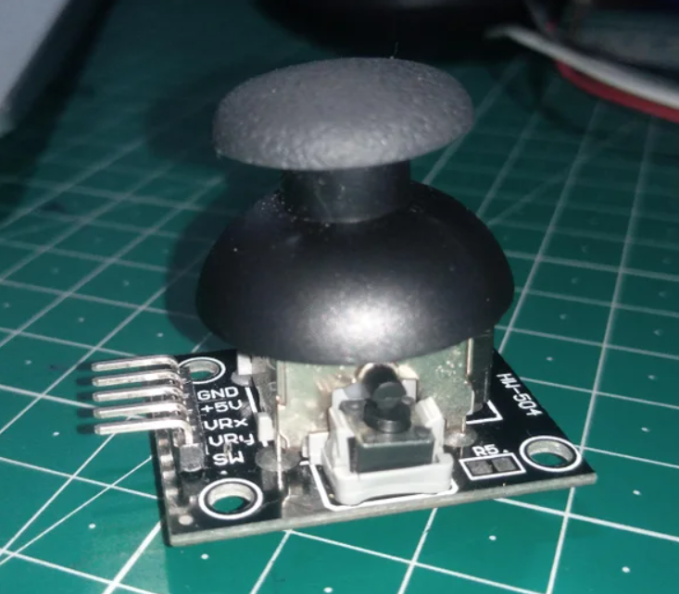
Circuit Components

Slide 7
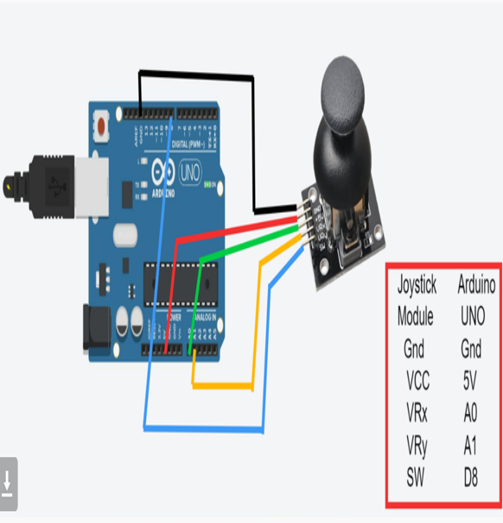
How to Build the Circuit
The joystick module has five pins: GND (ground), VCC (power), VRx (X-axis output), VRy (Y-axis output), and SW (switch). These pins are connected to the corresponding pins on the Arduino as shown in the diagram.

Slide 8
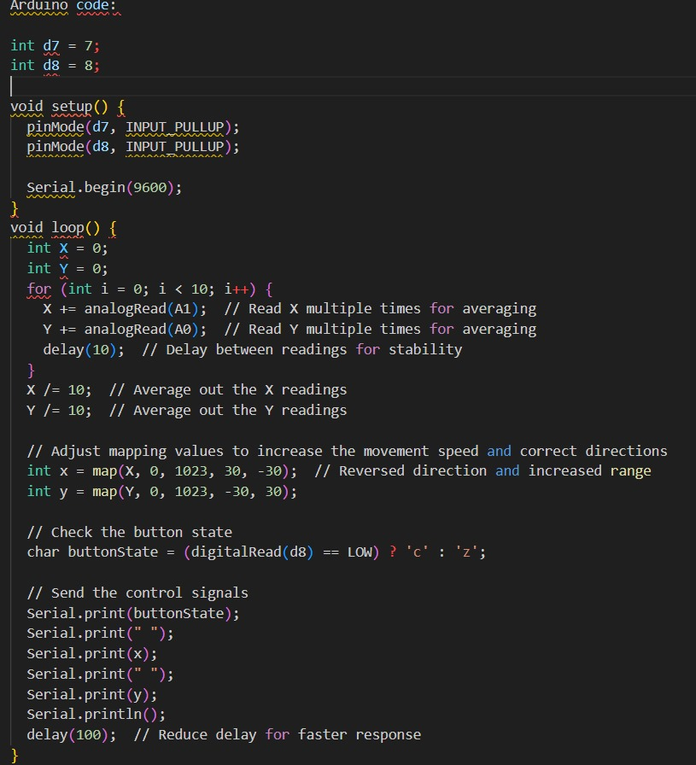
ARDUINO CODE

Slide 9
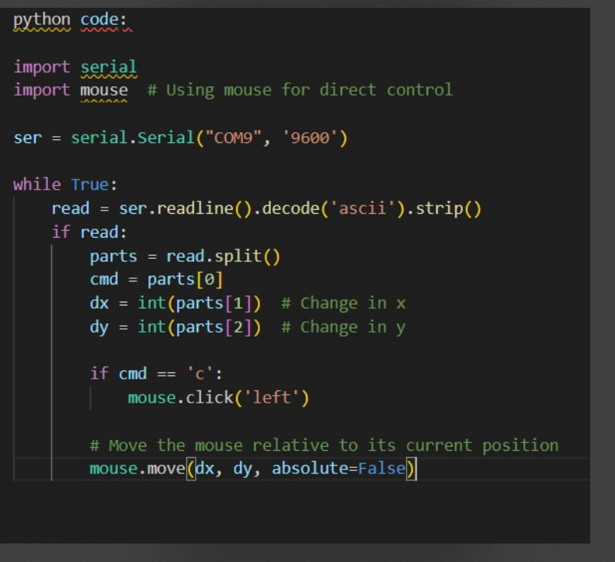
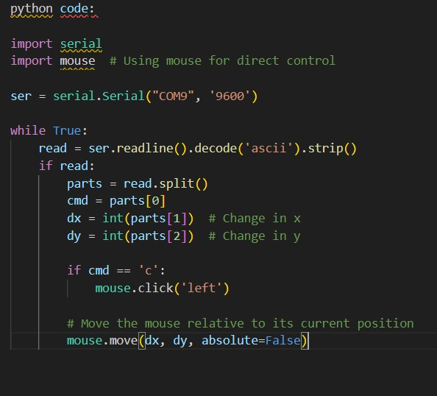
PYTHON CODE

Slide 10
EXPLANATION
PYTHON CODE
The Python code reads the serial input from the Arduino and translates these values into mouse movements using the `mouse` library. The joystick's pushbutton is used to simulate a mouse click. Key Parts: - `import mouse`: Imports the mouse control library. - `ser.readline()`: Reads the joystick values from serial input. - `mouse.move()`: Moves the mouse pointer. - `mouse.click()`: Simulates a mouse click.

Slide 11
CONCLUSION
This project successfully demonstrates how to interface a joystick module with an Arduino UNO to control a computer mouse. By utilizing both Arduino and Python code, the joystick movements are effectively translated into mouse movements and clicks on the PC. This project showcases practical applications for custom input devices and assistive technologies, providing an innovative solution for enhancing user interaction with computers. The detailed instructions and code explanations ensure that others can replicate and build upon this project for various applications.

Slide 12
THANK YOU

